Slide 1
FOOD TRENDS:
Based on Customer Satisfaction
TEAM-05
Under the Guidance:
Pavithra Kannan mam

Slide 2
TEAM MEMBERS:
01
Hema Latha
02
Samvedita Bisariya
03
Dipa Majumder
04
Udit Mathur

Slide 3
METHODOLOGY
Data Loading
Data Cleaning and Preparation
Visualization and Analysis

Slide 4
Overview:
1. Data Loading
The first step was to load the raw data into Power BI. We began by connecting to the restaurant_customer_satisfaction.csv file, which contains all the customer feedback and behavioural data.
2. Data Cleaning & Preparation
After loading the data, several key transformations were performed in Power Query to prepare the data for analysis. The primary goal was to create a clean, organized data model.
            Created AvgRating Column: A new column named AvgRating was created to provide a single, average satisfaction score for each customer. This was calculated by averaging the ServiceRating, FoodRating, and AmbianceRating columns.
Created DimProduct Table: A new table called DimProduct was created. This table was designed to serve as a dimension table containing unique combinations of PreferredCuisine, MealType, and DiningOccasion. A unique ProductID was added to this table to simplify future analysis.

Slide 5
DimCustomer Table: A dimension table for customer information was created. It contains unique CustomerID along with descriptive data like Age, Gender, and Income.
3. Visualizations & Analysis
A Power BI dashboard was created to present key insights from the data. The visuals were made interactive using slicers for MealType and PreferredCuisine to allow for dynamic filtering.
Average Rating by Preferred Cuisine: A clustered bar chart was used to show the average rating for each cuisine type.
      Insight: The analysis revealed that Chinese and Mexican cuisines
      have the highest average ratings, while Indian and Italian
      have the lowest. This highlights areas for potential improvement
Average Spend by Dining Occasion: A bar chart was created to display the average amount of money customers spend based on their dining occasion.
  Insight: This visual showed that customers celebrating a Celebration
  tend to have the highest average spend, indicating this is a
  highly profitable dining occasion.

Slide 6
Customer Satisfaction by Visit Frequency: A column chart was used to analyze how customer satisfaction varies with their visit frequency.
  Insight: The visual demonstrated that Weekly visitors have the highest
  satisfaction ratings, suggesting that customer loyalty is a key
  driver of satisfaction.

Slide 7
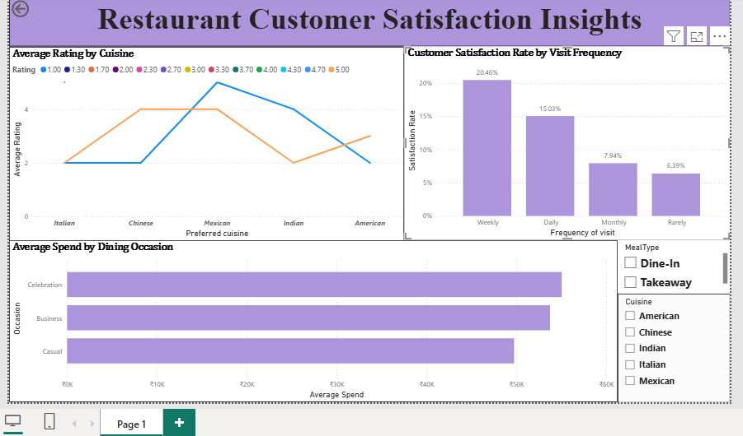

  OUTPUT:

Slide 8
PURPOSE:
Customer Segmentation
Group customers into personas based on dining frequency, spending habits, and loyalty program membership (e.g., “Frequent Diners,” “Casual Visitors,” “High Spenders”).
Satisfaction Analysis
Identify factors that strongly influence High Satisfaction (e.g., food quality, service rating, ambiance, wait time).
Preference Insights
Detect trends in preferred cuisines, meal types, and dining occasions across demographics and regions.
Behavioral Trends
Analyze correlations between income, spending, and loyalty program engagement.
Actionable Recommendations
Suggest improvements in service efficiency (wait time), marketing campaigns (loyalty targeting), and menu design (cuisine & meal type demand).
Dashboard Integration (Power BI)
Deliver an interactive view of sentiment, satisfaction, and personas, aligning with the document’s outlined modules (Sentiment, Product Insights, Segmentation, Strategy).

Slide 9
CONCLUSION
The initial data analysis successfully identified key trends in customer behaviour and satisfaction. The dashboard provides actionable insights that can be used to inform business decisions related to cuisine offerings, marketing strategies, and customer loyalty programs. The preparation of a robust star schema, including both the DimProduct and DimCustomer tables, lays a strong foundation for a more advanced data model and complex analysis in future milestones.

Slide 10
THANK YOU

